Slide 1
V2X Platooning Optimal Control
CE 295: Data Science for Energy, Fall 2021
Shih-Hung Chiu, Margaret D’Auria, Joe Koszut, Tianhao Wu, Jarvis Yuan, & Aoyu Zou

Slide 2
Outline
Introduction & Background
What is Vehicle Platooning?
Focus of Study
Why does this matter?
Relevant Literature
Methods
Algorithms and Problem Structure
Single Vehicle Optimal Control
3-Vehicle Platooning Optimal Control
Aerodynamic Drag
Results
Traffic Light Simulation (TLS)
Results: TLS Parameter Study
Future Work

Slide 3
Introduction & Background

Slide 4
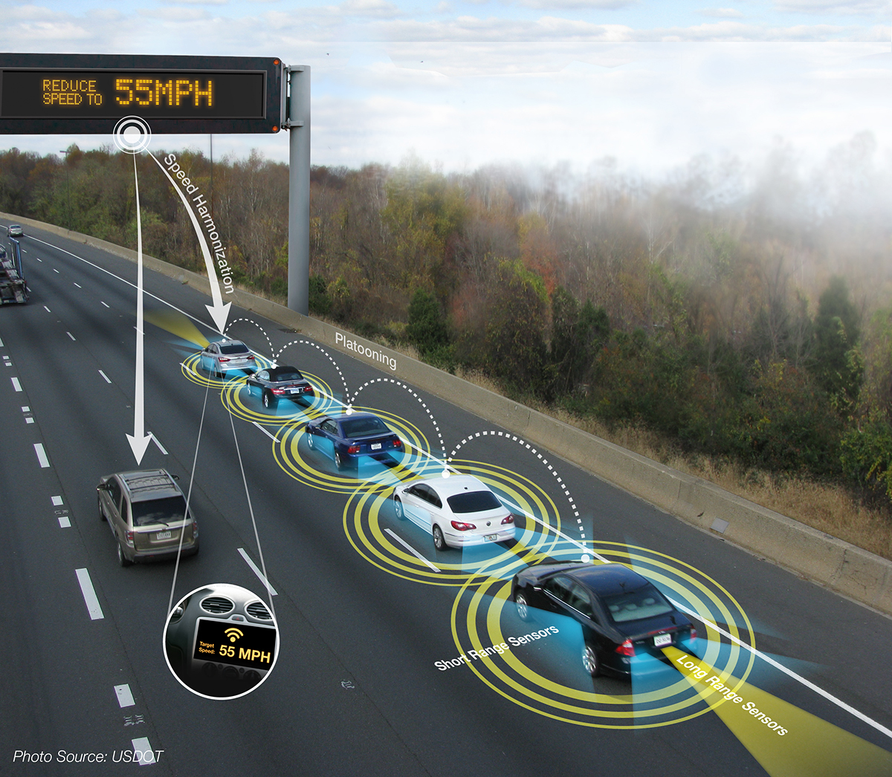
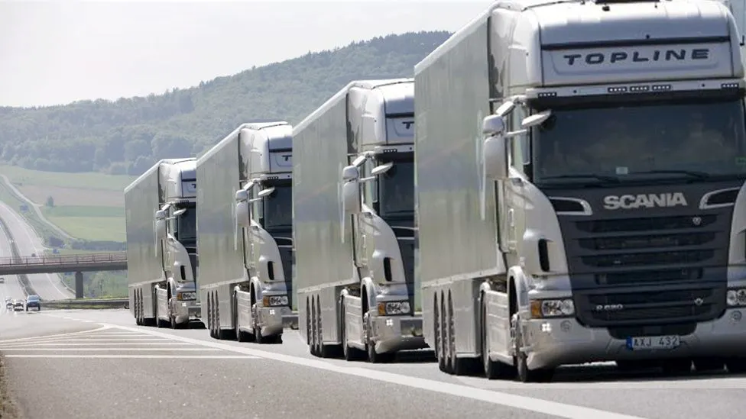
What is Vehicle Platooning?
Vehicle fleet automation with integrated sensor array, active safety systems, and controllers to synchronize platoon acceleration and braking
Vehicle-to-vehicle (V2V) communication [2]
Vehicle-to-everything (V2X) communication [1]
Emerging area of research in control and optimization: save time, money, energy
Common scenarios this could apply to:
Trucks in highway driving
Cars in highway driving
Cars in urban driving - our selection
[1]
[1] “Platoon (automobile)” (5 Oct 2021). Wikipedia. Retrieved on 06 Nov 2021, 13:46, from https://en.wikipedia.org/wiki/Platoon_(automobile).
[2] Ashley, Steven (18 Nov 2014). “Robot truck platoons roll forward.” BBC. Retrieved on 06 Nov 2021, 13:49, from https://www.bbc.com/future/article/20130409-robot-truck-platoons-roll-forward
[2]
Notes:
Margaret

Slide 5
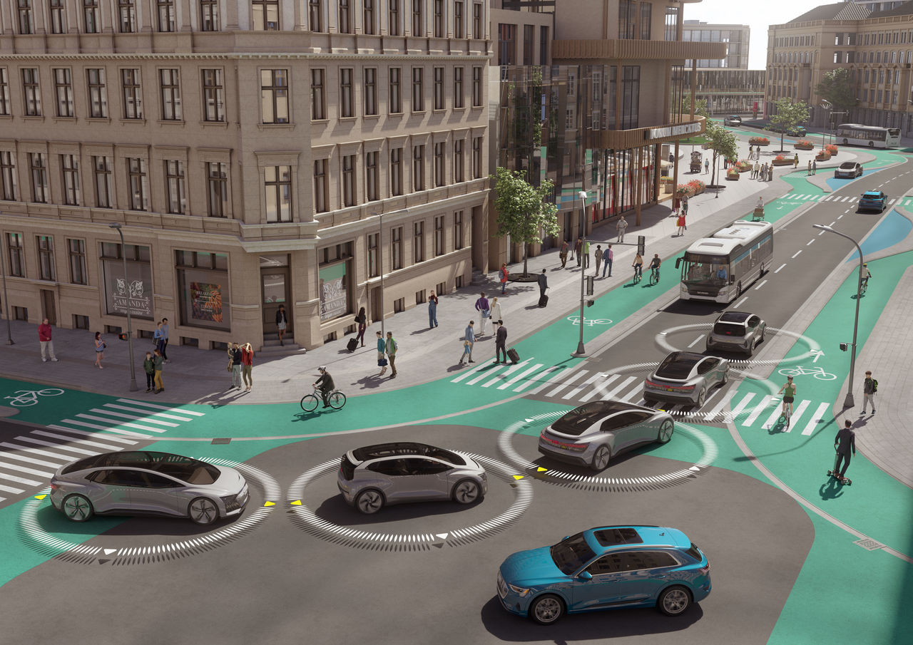
Focus of the Study
Cars platooning in an urban area
More obstacles and more powertrain varieties
Focus on battery electric vehicle (BEV) platoons
Optimal platoon trajectory
Given timed traffic lights and spacing in an urban area
Output: optimal trajectory for the car to save time and energy
[3]
[3] Schneider, Tilman (16 Sept 2018). “Audi Study: No Congestion in the City of the Future.” Audi MediaCenter. Retrieved on 06 Nov 2021, 13:52, from https://www.audi-mediacenter.com/en/press-releases/audi-study-no-congestion-in-the-city-of-the-future-10736.
Notes:
Margaret

Slide 6
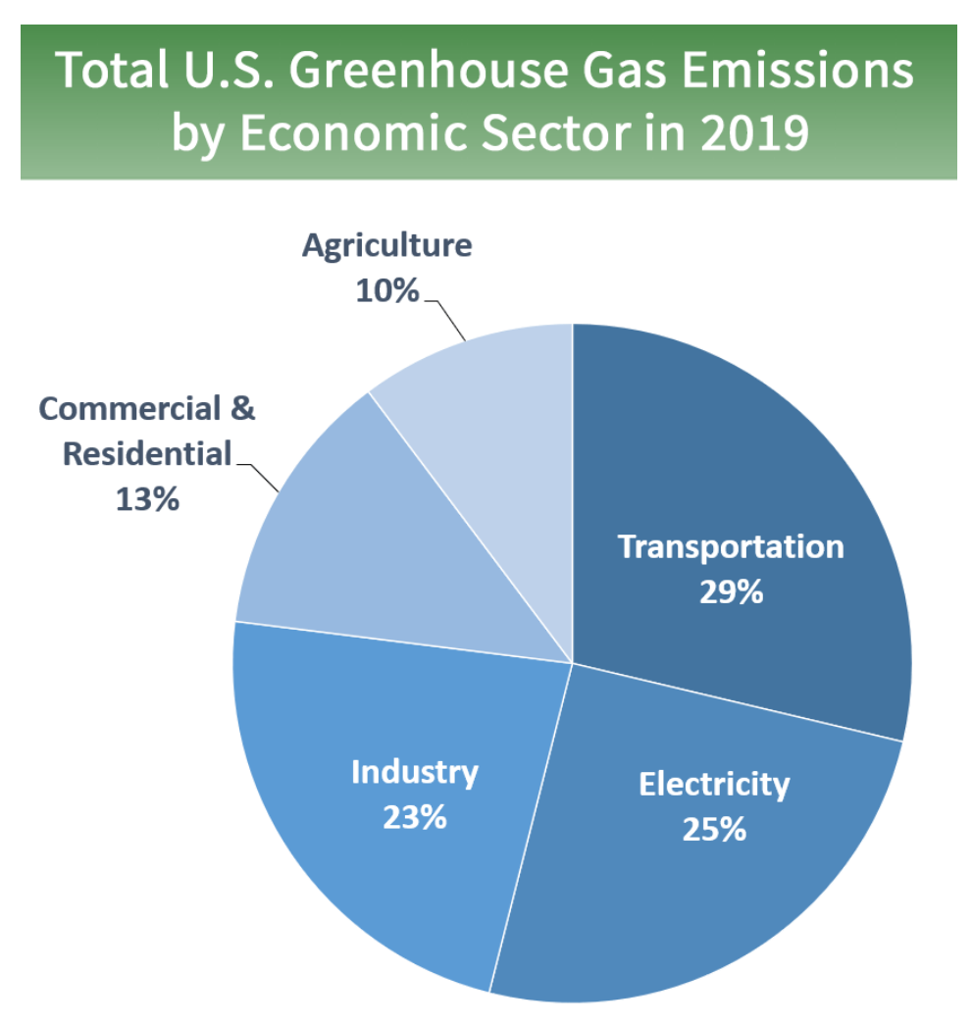
Why Does This Matter?
Energy saved → reduced emissions!
Transportation is largest emissions sector
Electricity second - electric vehicles
Reducing carbon emissions benefits the planet and its occupants
Time saved is a huge advantage for people…
Traveling to and from work → more free time or family time
Traveling to and from a destination → time saved in the vehicle
Transporting goods → quicker shipping time, can sell more
[4] “Sources of Greenhouse Gas Emissions” (2021). United States Environmental Protection Agency. Retrieved on 06 Nov 2021, 14:01, from https://www.epa.gov/ghgemissions/sources-greenhouse-gas-emissions.
[4]
Notes:
Margaret

Slide 7
Relevant Literature
Adaptive cruise control and cooperative adaptive cruise control can save energy [5]
Platooning allows for closer headway → smaller drag, saves energy [6]
Traffic lights in urban settings cause stops and delays, responsible for a large amount of emissions [7]
Main conclusion: traffic lights increase emissions, cruise control + platooning decrease emissions
Can we combine the two for a more powerful energy savings effect?
[5] Wang, Z., Wu, G., \& Barth, M. J. (2018, November). A review on cooperative adaptive cruise control (CACC) systems: Architectures, controls, and applications. In 2018 21st International Conference on Intelligent Transportation Systems (ITSC) (pp. 2884-2891). IEEE.
[6] Ma, F., Yang, Y., Wang, J., Liu, Z., Li, J., Nie, J., ... \& Wu, L. (2019). Predictive energy-saving optimization based on nonlinear model predictive control for cooperative connected vehicles platoon with V2V communication. Energy, 189, 116120.
[7] C. Sun, J. Guanetti, F. Borrelli and S. J. Moura, "Optimal Eco-Driving Control of Connected and Autonomous Vehicles Through Signalized Intersections," in IEEE Internet of Things Journal, vol. 7, no. 5, pp. 3759-3773, May 2020, doi: 10.1109/JIOT.2020.2968120.
Notes:
Margaret

Slide 8
Methods

Slide 9
Problem Structure
Mixed-integer second order cone program (MISOCP)
Modeling language: CVXPY
Optimization solver: MOSEK
Two cases
Single Vehicle
3-Vehicle Platoon
EV Energy Optimization
Single Vehicle
3-Vehicle Platoon
Nominal Traffic Light Timing
Parameter Study
Nominal Traffic Light Timing
Adjusted Traffic Light Timing
Notes:
Joe

Slide 10
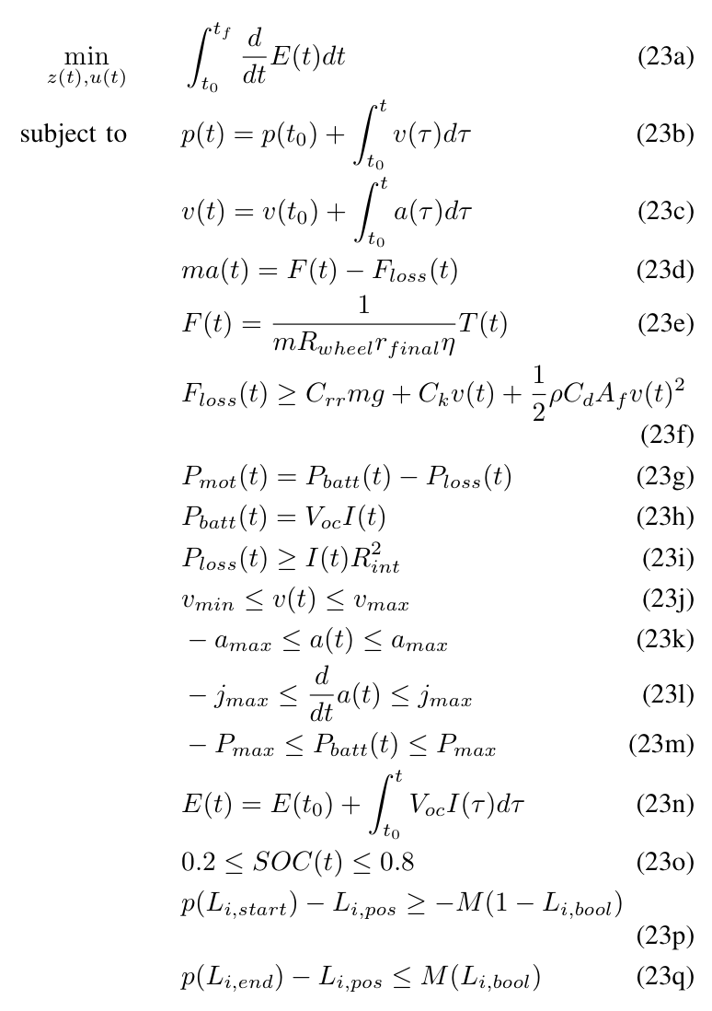
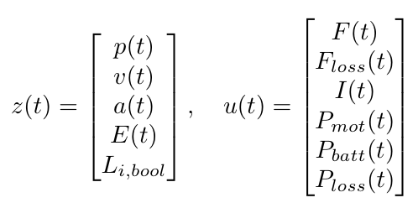
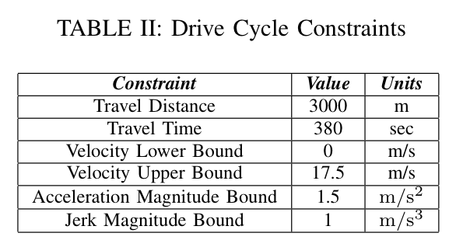
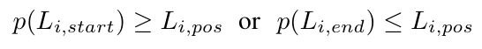
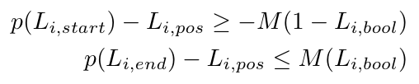
Single Vehicle Optimal Control
Longitudinal vehicle dynamics modeled
Nonlinear dynamics create need for second order cone constraints
Traffic lights using the Big-M method
Creates need for a mixed-integer program
Application of Big-M method
Notes:
Joe

Slide 11
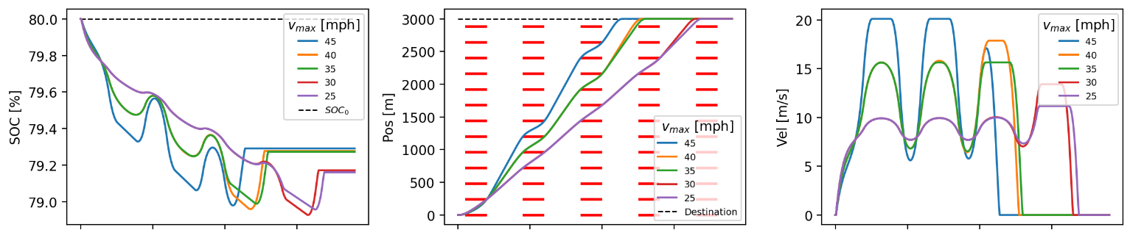
Single Vehicle Parameter Study Example
Independent variable: Speed limit
Dependent variable: Energy consumption
Higher speed leads to a lower energy consumption*
*Savings eventually plateau likely due to higher aerodynamic drag at higher speeds
Time [s]
Time [s]
Time [s]
Notes:
Joe

Slide 12
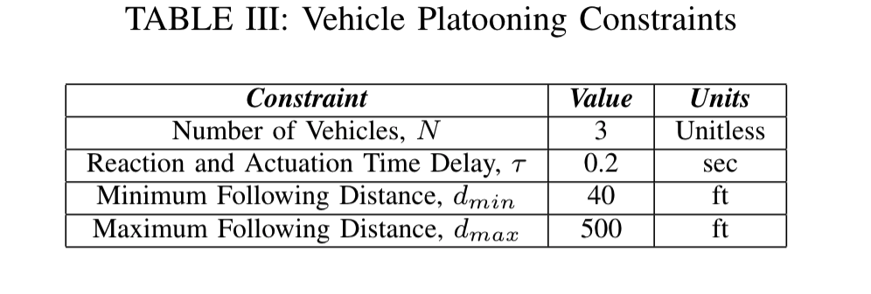
3-Vehicle Platoon Optimal Control
x1(t>0)
1
τ・v[0][t]
d_min ≤ H[0][t] ≤ d_max
Trajectory copying of the leading vehicle with constraints on:
Initial state, x1[veh][0],
Following distance, H[veh][t],
Reaction and actuation time delay, τ
Assumes no vehicle overtaking and turning,
Allows for ‘breakaway’ from the leading vehicles in light of red phase
L
2
τ・v[1][t]
d_min ≤ H[1][t] ≤ d_max
3
x1(t=0)
1
H[0][0] = d_min
L
2
H[1][0] = d_min
0
3
Notes:
We took inspiration from various literatures to incorporate both vehicle fleet and traffic light in an urban environment which address the missing component in our research findings
PENNDOT specified a maximum of 3 vehicle are allowed in a vehicle platoon while other constraints are specified in our literature review
Initial state: vehicle are parked with a minimum following distance with consideration of the vehicle length
At some time t: we are includes a reaction and actuation time delay, tau, that is modeled based on the speed of the leading vehicle to more accurately a real world driving scenario, this also serve as a penalty towards the consideration of aerodynamic drag

Slide 13
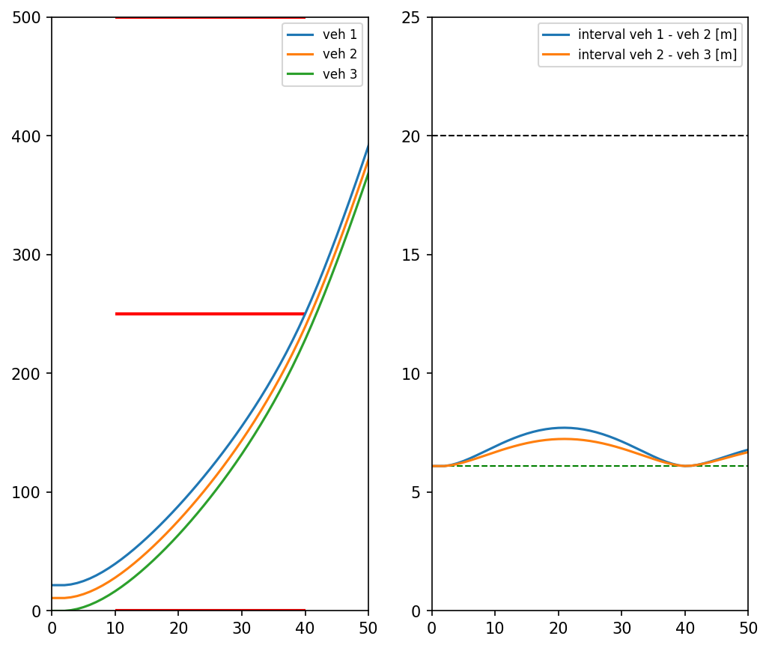
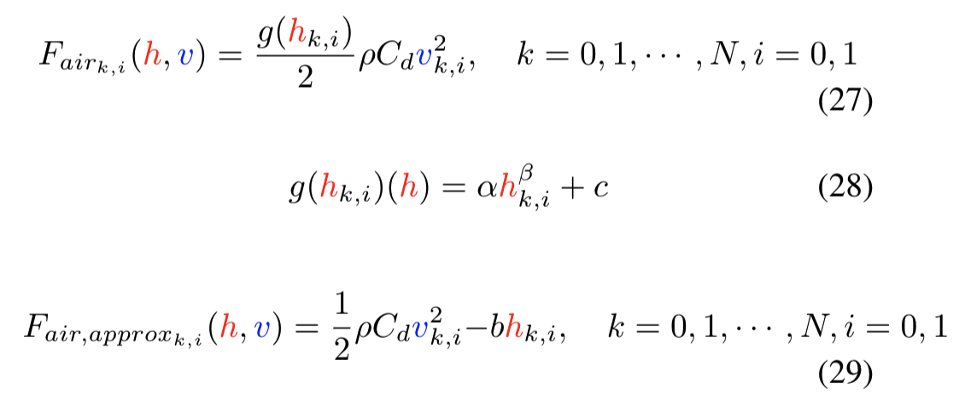
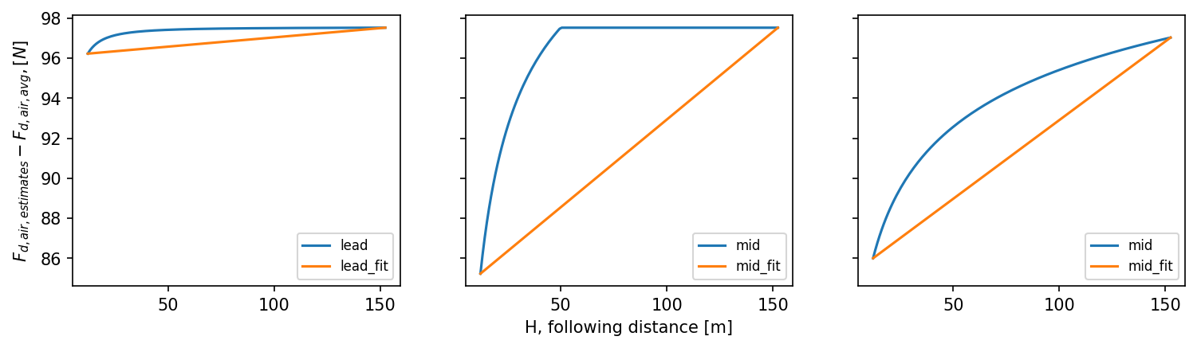
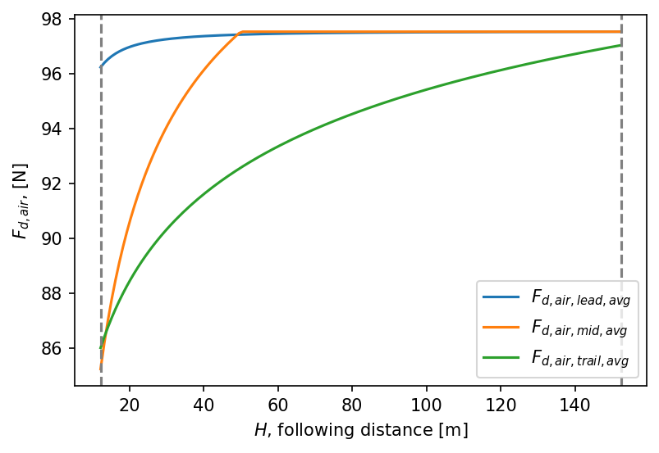
Aerodynamic Drag
Vehicle trajectory and following distance for t <= 50s
F_air(v,C_d(h))→ non-convex in formulation (27) for each vehicle in the platoon,
Using the velocity upper bound, we fixed the value of v_avg to estimate an average drag value and linearly fitted and adjusted for h (29)
Time [s]
Time [s]
Notes:
Jarvis
The modeling of an accurate aerodynamic drag of the platooning vehicles depends on the position of the vehicle in the platoon, velocity, and also the following distance to the vehicle ahead,
We are able take into the consideration of the following distance in the form of a fraction on C_d constant in (28) but would make our optimization formulation nonconvex,
Solution is to approximate the overall aero drag linearly in following distance,
Plot on top right corner is just for demonstration,

Slide 14
Results

Slide 15
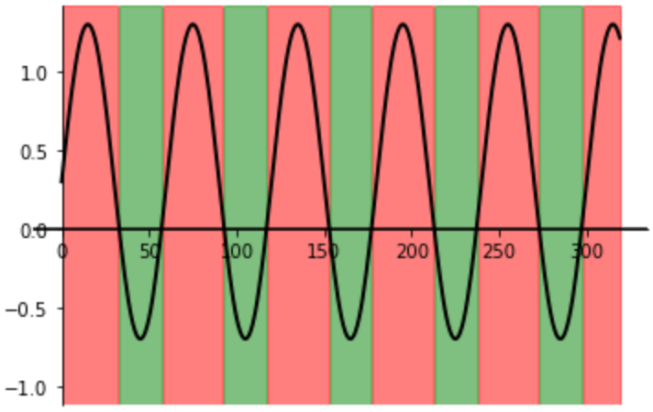
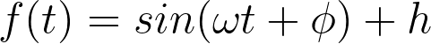
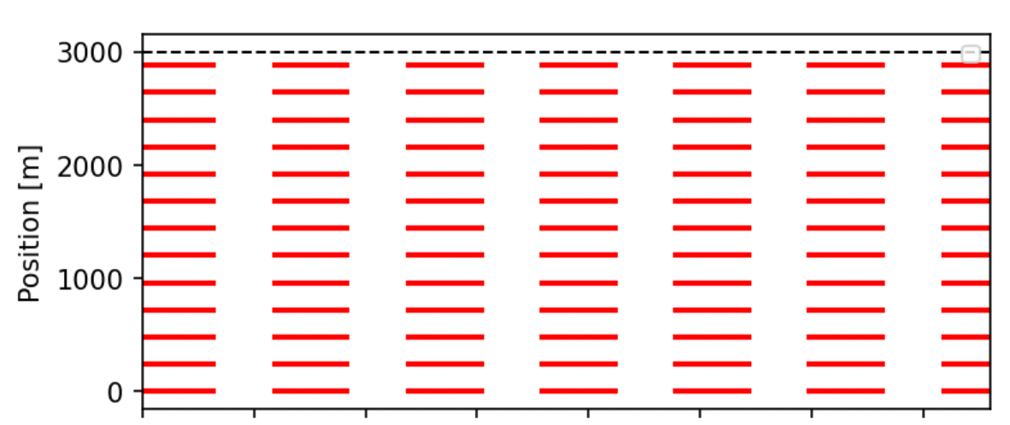
Traffic Light Simulation
f(t) < 0: green light
ω: traffic light cycle period
φ: phase shift
h: controls green-light duration
T = 60s
ω = 2𝛑/T
φ = 0
h = 0.3
Time [s]
Notes:
Aoyu

Slide 16
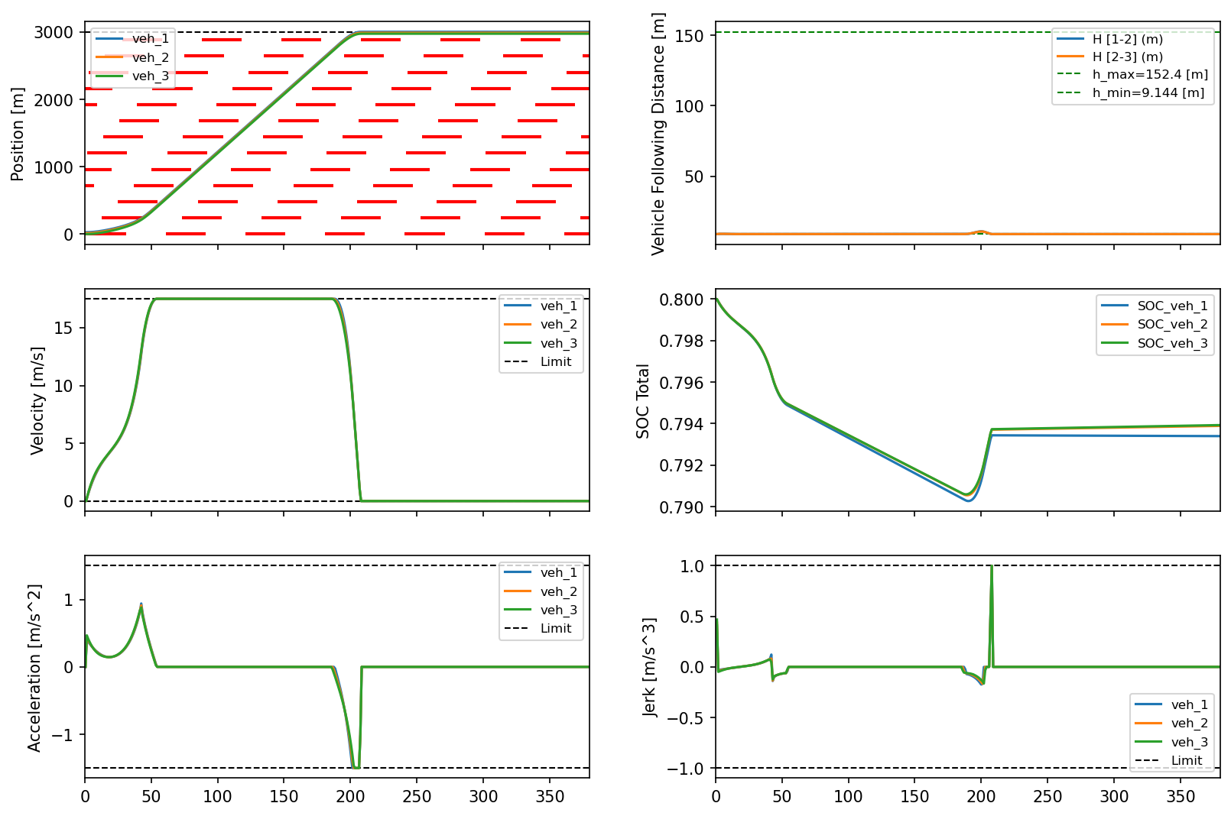
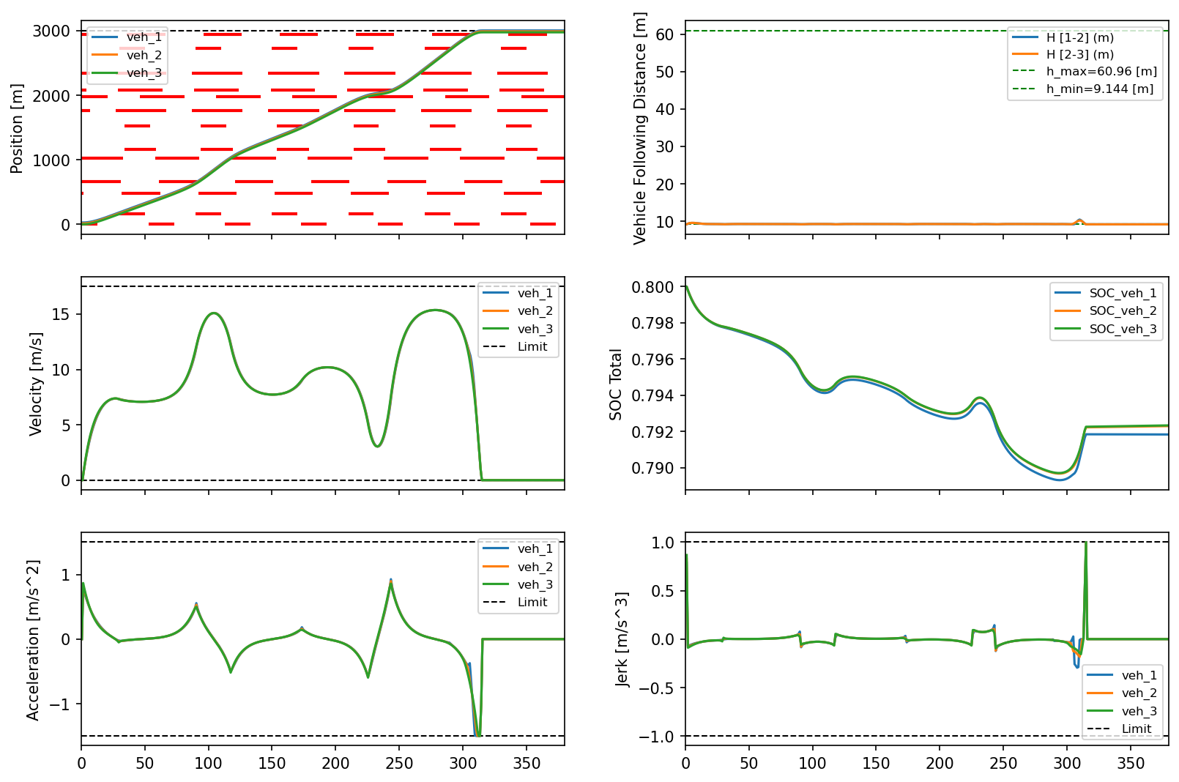
Uniform phase shift
Random parameters
Time [s]
Time [s]
Time [s]
Time [s]
Results: Traffic Light Simulation Parameter Study
Notes:
Aoyu

Slide 17
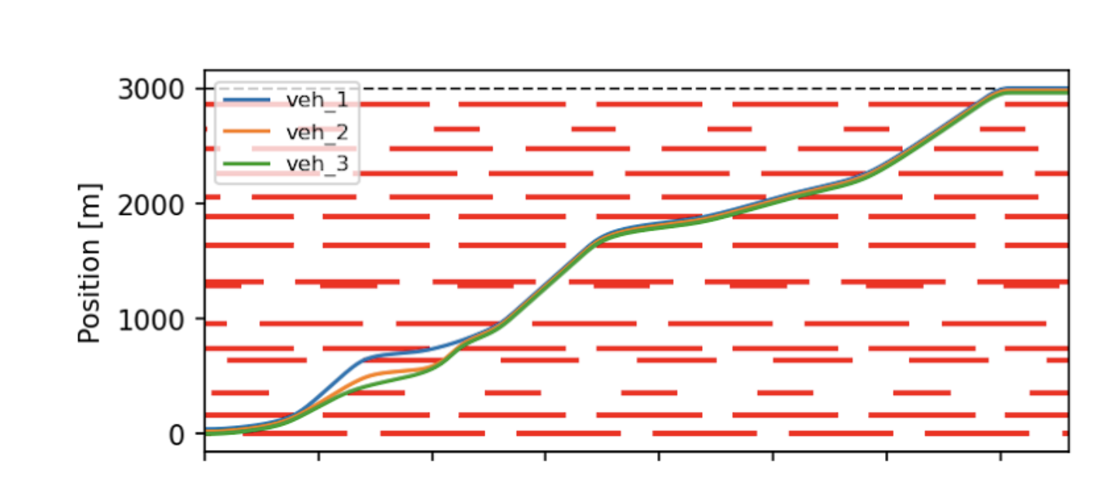
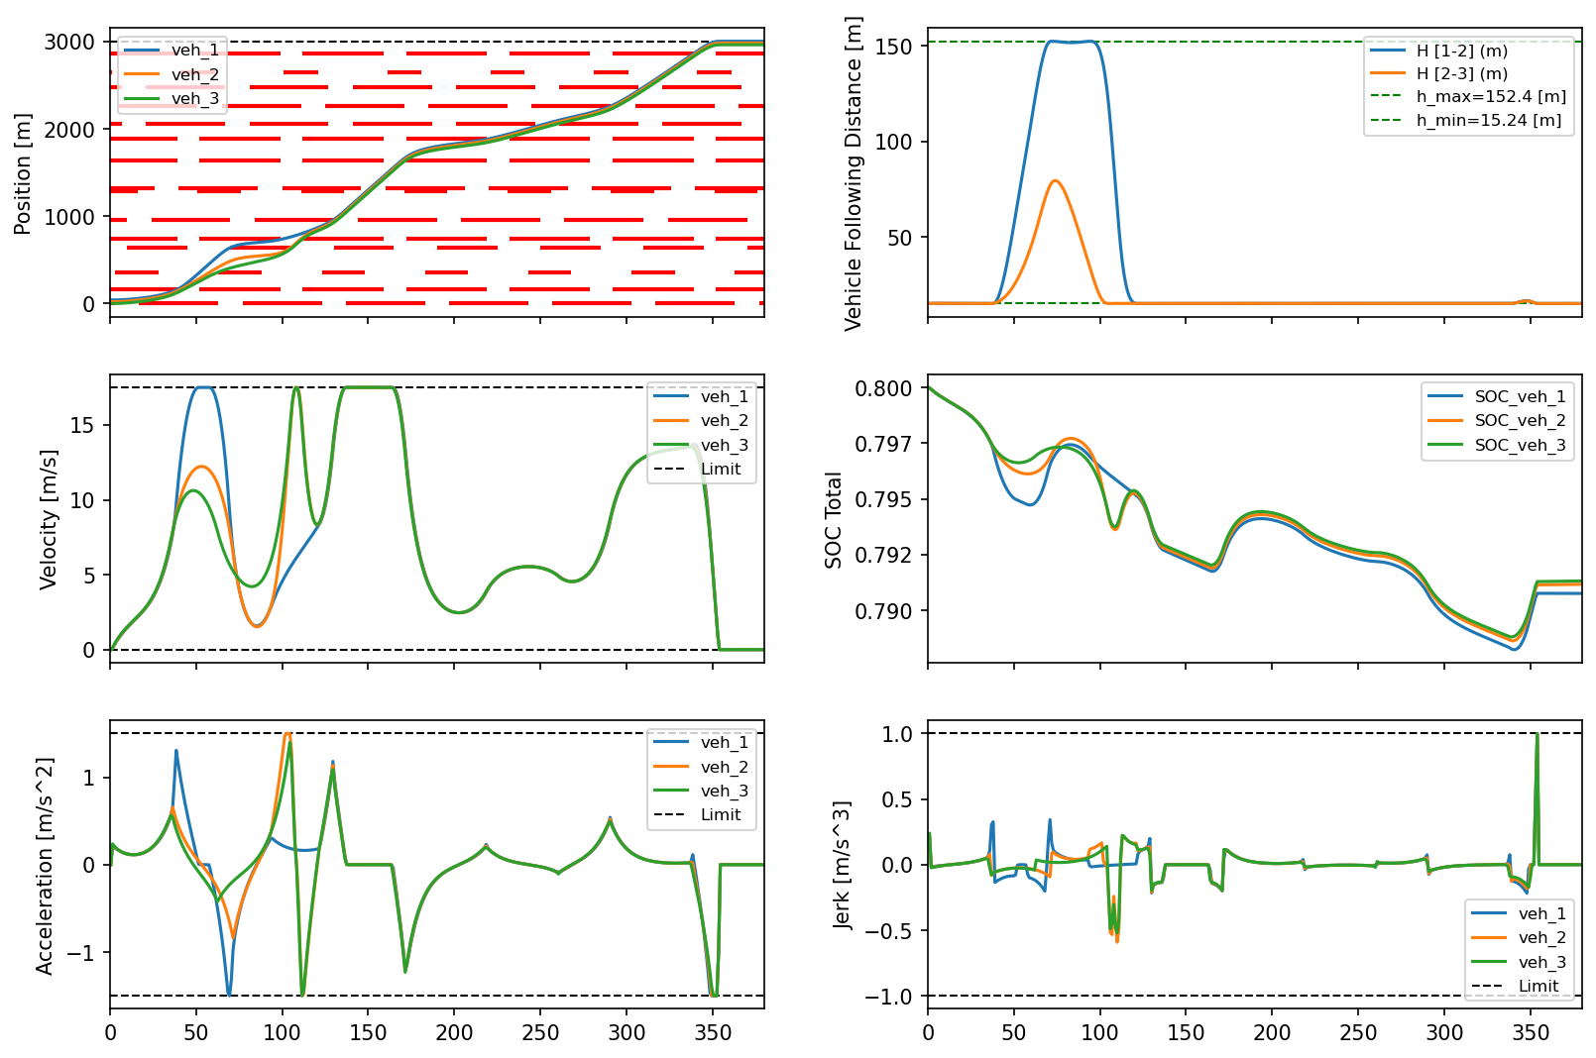
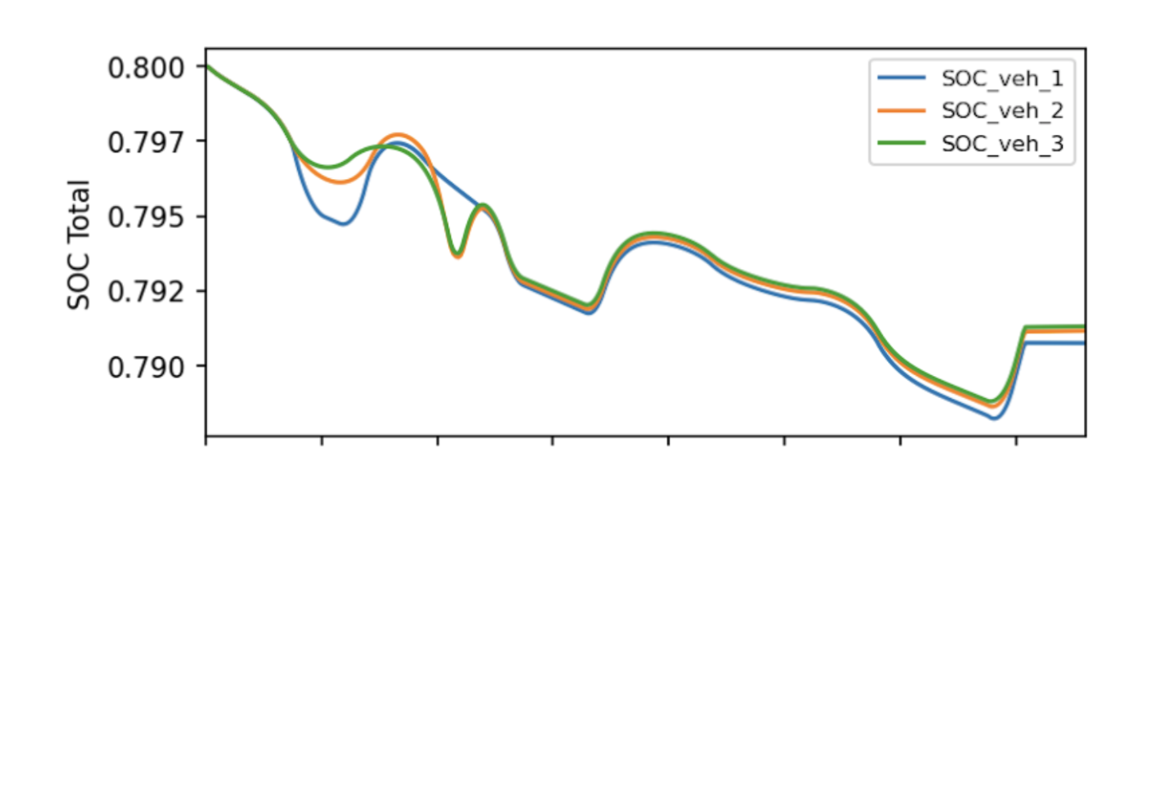
Random parameters + following distance
Time [s]
Time [s]
Results: Traffic Light Simulation Parameter Study
Notes:
Aoyu
[1280 - 1320], 40m for the shortest block

Slide 18
Future Work

Slide 19
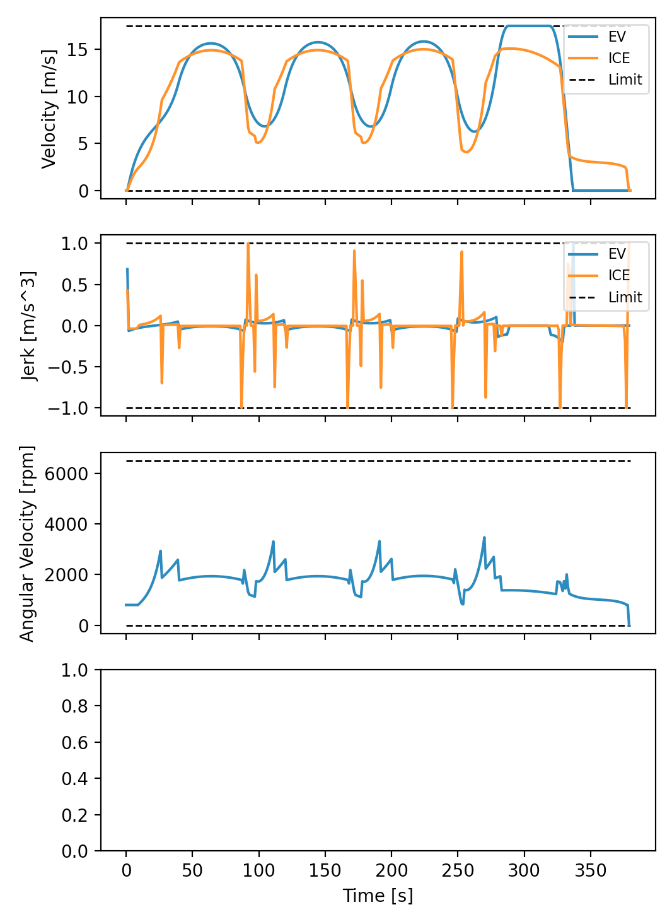
Future Work
ICE, PHEV powertrains
Add traffic lights as a decision variable with constraints
Anticipation of the length and position of platoons
Partial knowledge of traffic light parameters
Background traffic (non-V2X)
Notes:
Eric

Slide 20
Thank You!

Slide 21
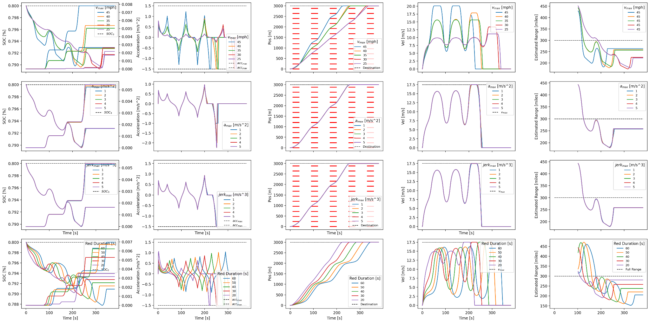
Results: Single Vehicle (BEV) Parameter Study

